Slide 1
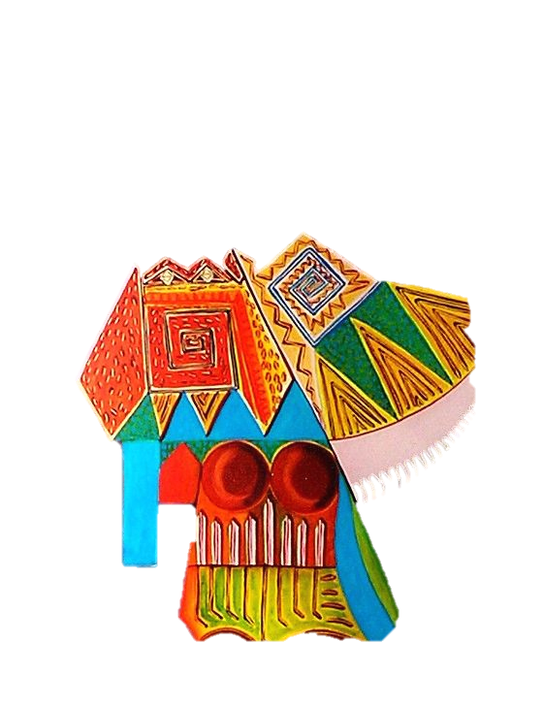
Participatory Theatre as an Intervention and Research Tool in Preventing and Countering Violent Extremism
Dr. Fathima Azmiya Badurdeen
Department of Social Sciences, Technical University of Mombasa

Slide 2
Overview
To discuss the centrality of participatory theatre in PCVE work
To look at the theatre as an intervention tool in PCVE work
To present and analyse theatre as a research tool in PCVE
To present other forms of art used for research in PCVE

Slide 3
What is PCVE?
Defining Violent Extremism in Kenya
Violent Extremism in the Coast
Local experiences in PCVE

Slide 4
The Use of Theatre in PCVE
Use of multiple senses
Focus on emotions
‘From the heart approach’
Touching affective filters
A humane approach
Builds on an existing oral culture/history
Learning the realities in the local context

Slide 5
Forms of Art used:
Drama, movies, music, talent shows, theatre
Participatory theatre by MAYE
Street Theatre by CICC
Other:
Watatu Movie
Graffiti and Murals
Body Maps

Slide 6
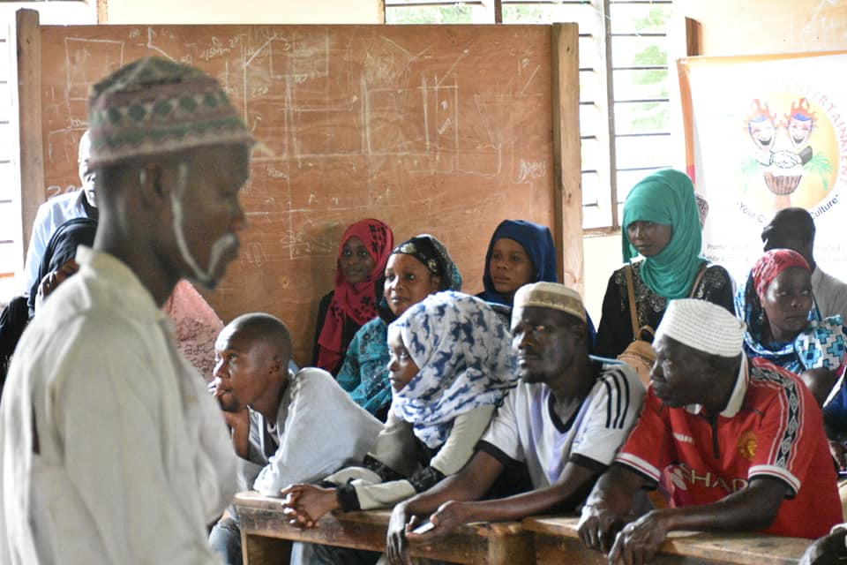
Participatory Theatre in PCVE

Slide 7
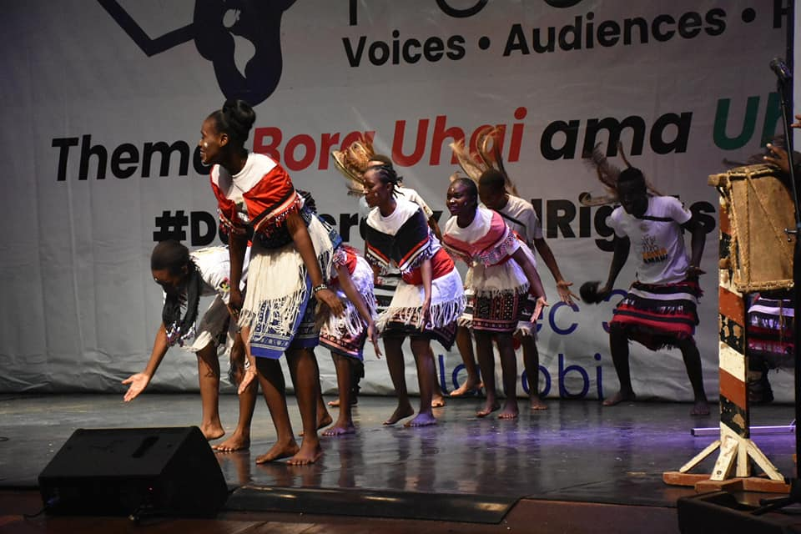
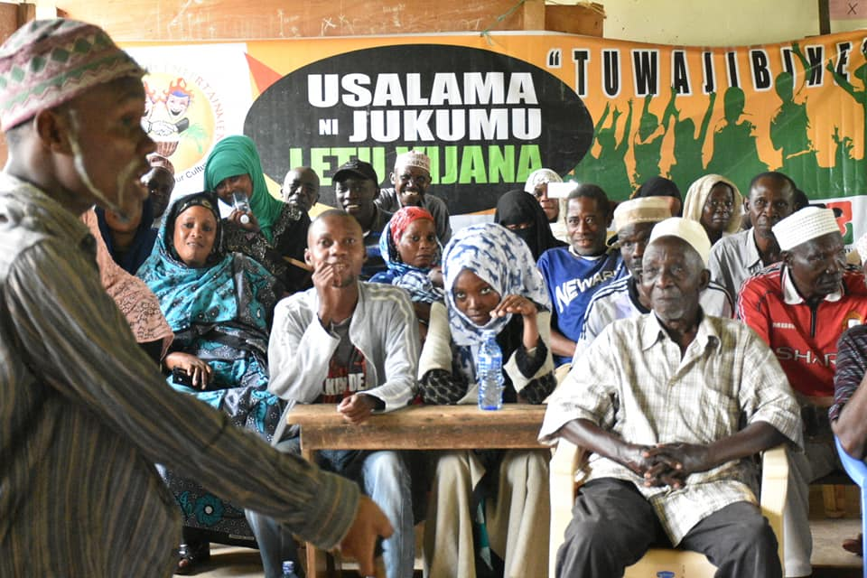
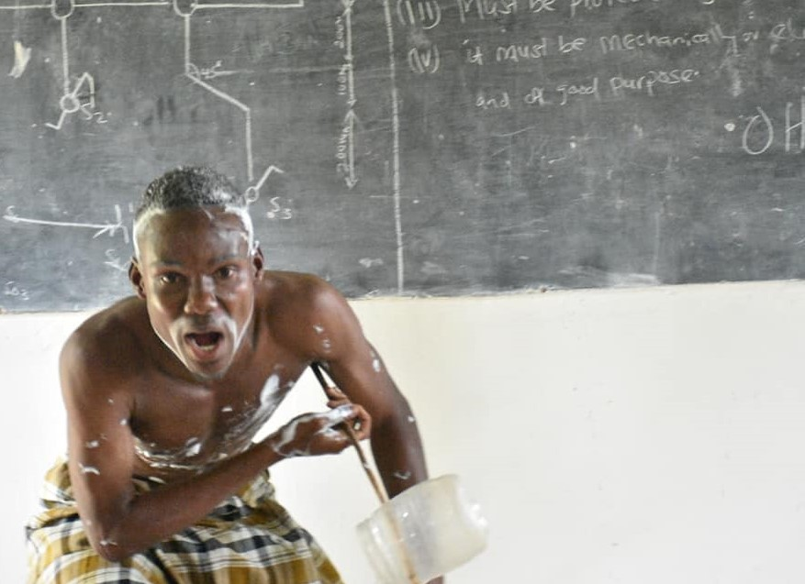
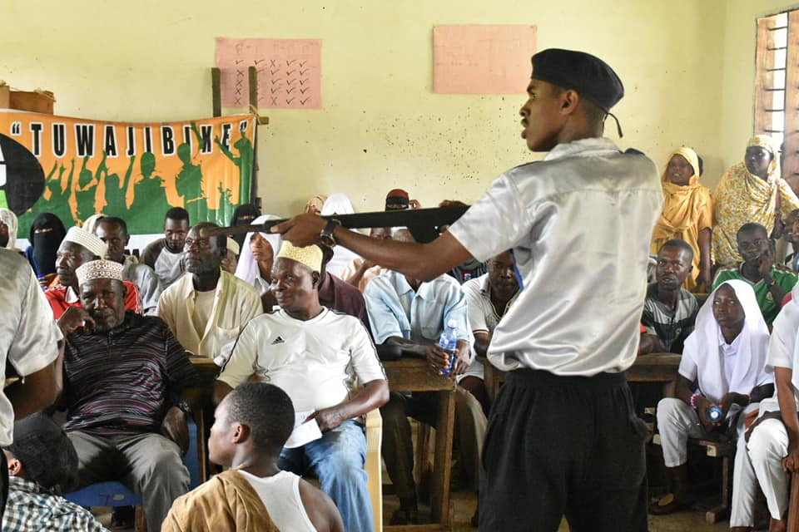

Slide 8
Violence depiction and Emotions

Slide 9
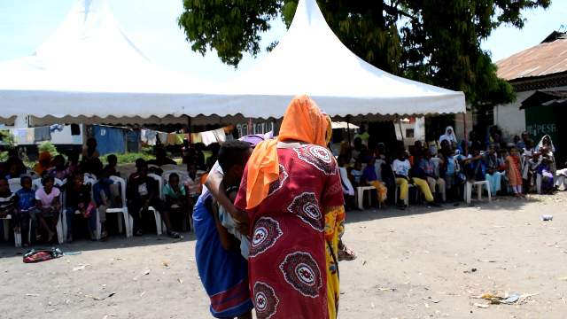
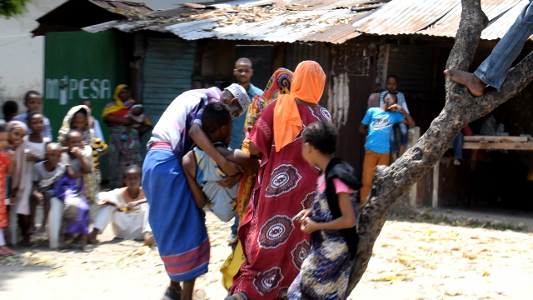
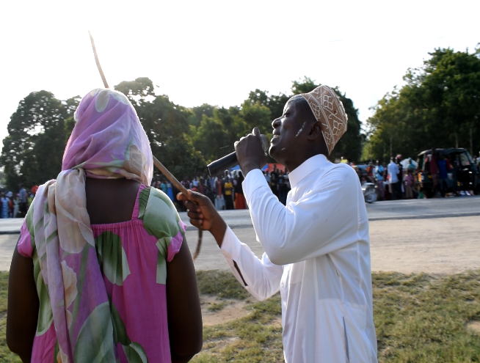
Participatory Educative Theatre
Event at Blue Bench Kisauni Mombasa County illustrating an act of warning young girls against being lured by promises of better lives if married to a VE group fighter (Photo by Justin CICC).
Participatory Educative Theatre outreaches at Kilifi Mkoroshoni market (Photo by Justin CICC).

Slide 10
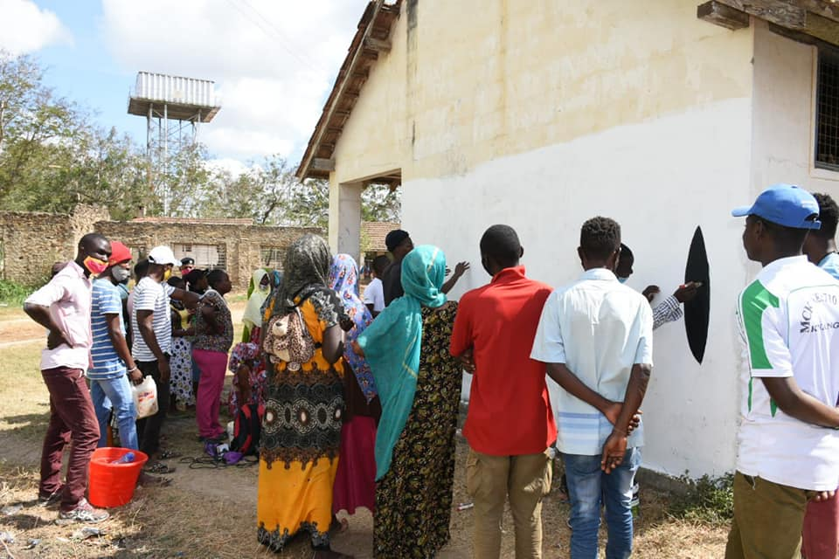
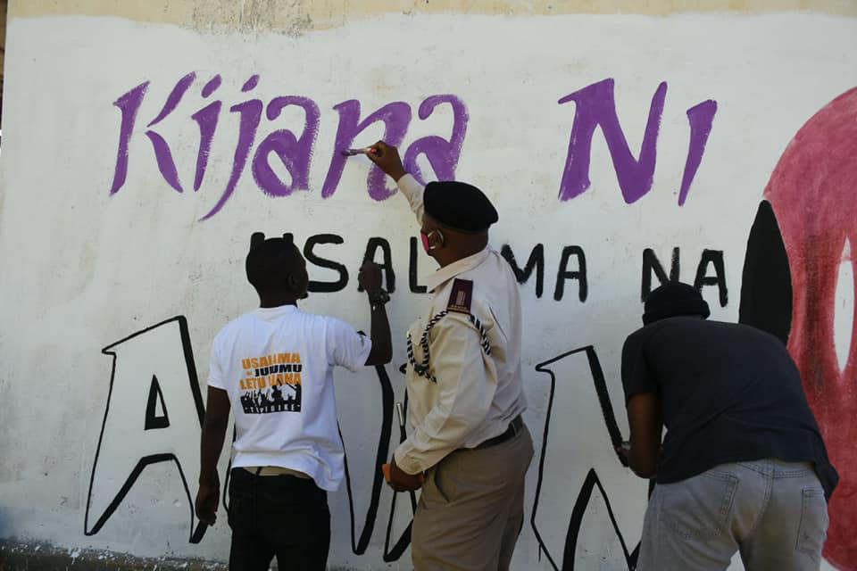
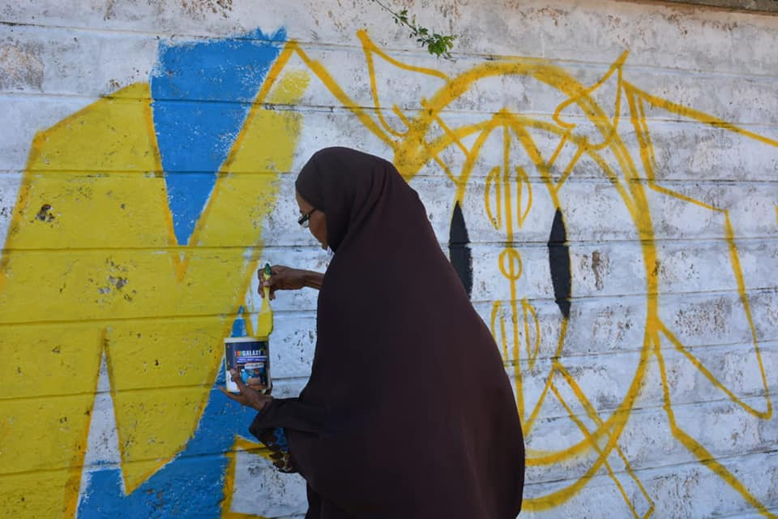
Murals

Slide 11
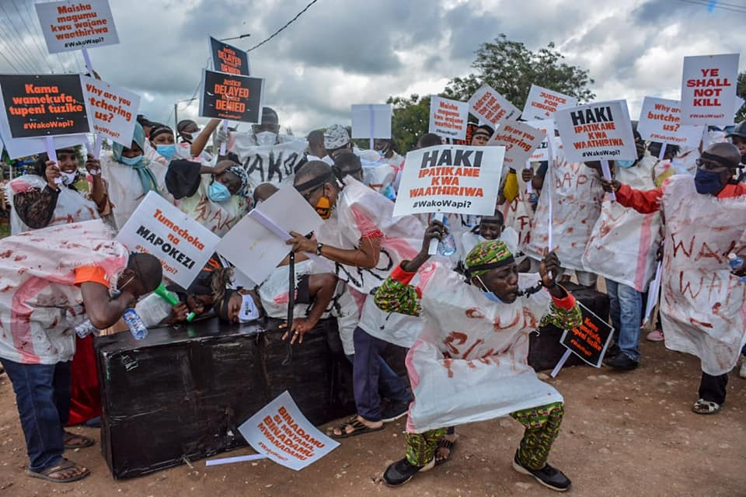
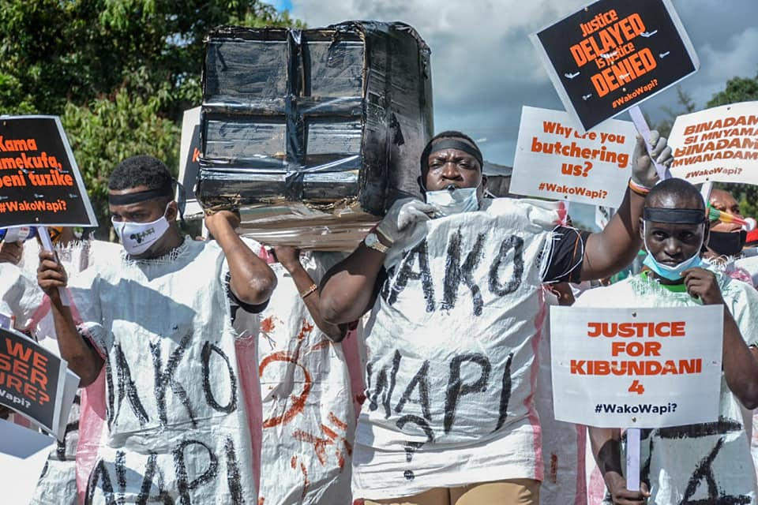
Performance and Activism

Slide 12
Participatory Theatre as a research tool
Used as a tool to gather baseline information for project interventions
Used as a tool to stimulate discussion prior to a focused group discussion

Slide 13
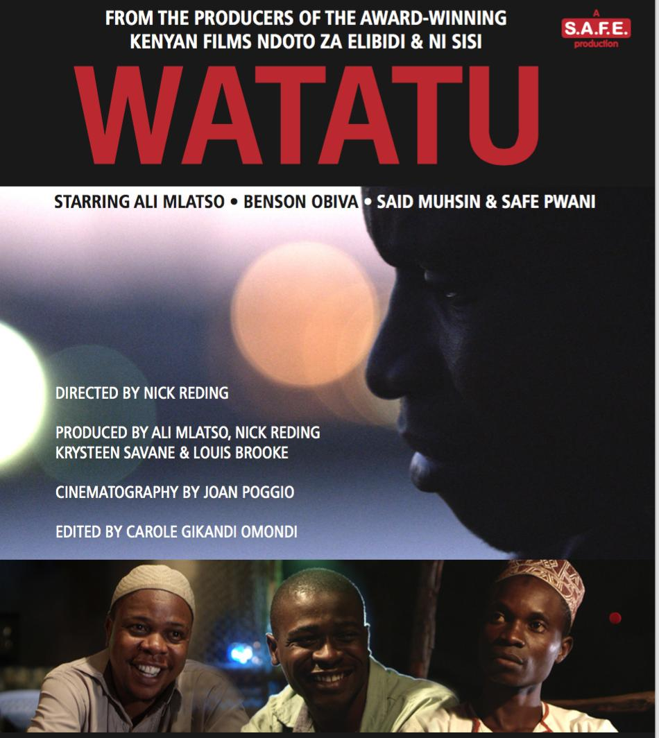
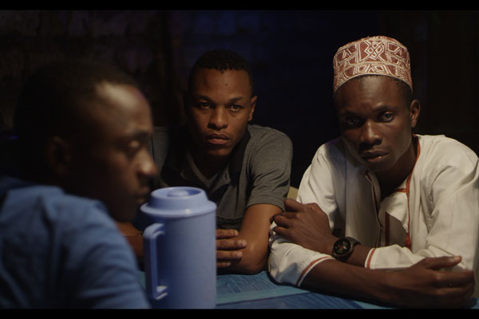
Watatu Movie

Slide 14
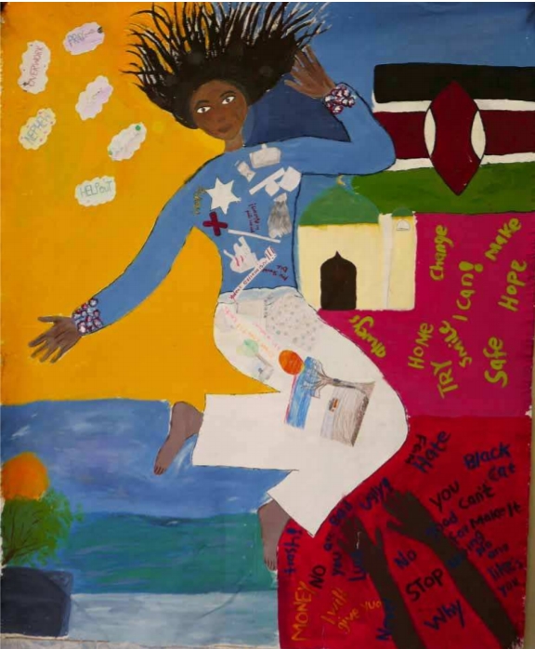
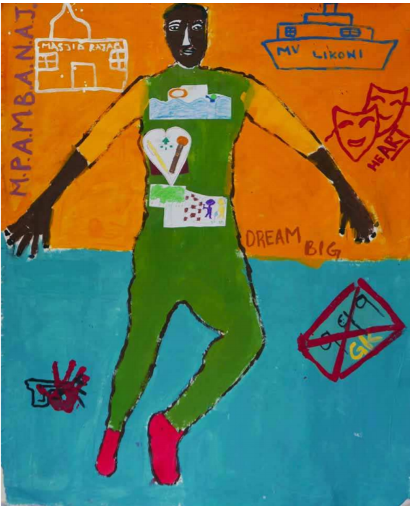
Other art methods: Body Maps

Slide 15
Thank you

